Slide 1
MoodMate
Team 4068
PARUL INSTITUTE OF TECHNOLOGY
Kapadiya Nirav kumar
Akbari Naimish
Vaghani Taxil
Kachhadiya Kishan

Slide 2
AGENDA
Personalized Recommendations: The website should use Deep Learning algorithms to analyze their mood to provide personalized recommendations of movies and songs.
Mood Detection: The website should use Cascade classifiers algorithms to detect user’s mood, such as angry, sad, fear, happy, disgust, surprise and neutral.
Interface: The website should have an easy-to-use interface that allows users to input their mood, browse recommendations, and play movies and songs directly on the website.

Slide 3
PROBLEM STATEMENT
In today's world where everyone is striving for achievement, but many people are succumbing to depression as a result of this struggle. Making a few poor decisions occasionally.
Also user not able to find thing on internet based on their sentiment (mood) when they needed.

Slide 4
PROJECT OVERVIEW
Image and Video Processing: The website would use image and video processing techniques to capture the user's facial expression from the camera.
Feature Extraction: The website would use feature extraction algorithms to extract relevant features from the image or video, such as the shape of the user's face, the position of their eyes, and the curvature of their lips.
Cascade Classifier Approach: The website would use a Deep learning cascade classifier algorithm, such as Haar Cascade Classifier, to analyze the extracted features and detect the user's mood.

Slide 5
PROJECT OVERVIEW
Personalized Recommendations: Once the user's mood has been detected, the website would use the Deep learning cascade classifier algorithm to provide personalized recommendations of movies and songs that correspond to the user's mood.
User Feedback: The website would allow users to contact developers for feedback on the recommended movies and songs, which would be used to improve the algorithm and provide better recommendations in the future.
Interface: The website would have an easy-to-use interface that allows users to activate the camera or upload a video, browse recommendations, and play movies and songs directly on the website.

Slide 6
WHO ARE THE END USERS?
Music and movie enthusiasts who are looking for a more personalized experience and want to discover new content based on their mood.
Individuals who want to relax or uplift their mood and are looking for recommendations that match their current emotional state.
People who are searching for a quick and easy way to find movies and songs that match their mood, without having to browse through long lists of content.
Individuals who are interested in new and innovative technology and are curious about how machine learning and deep learning algorithms can be used to provide personalized recommendations.

Slide 7
THE WOW FACTOR IN OUR SOLUTION
User-friendly Interface: The interface should be designed in a way that users can easily navigate and find the content they want.
Real-time Analysis: The website can provide real-time analysis of the user's mood, which can create a wow factor by providing immediate feedback and recommendations.
Constant Improvement: The website should regularly update its algorithm to improve the quality of its recommendations and stay up-to-date with the latest trends and user preferences. This constant improvement can create a wow factor by providing users with fresh content and a continually improving experience.

Slide 8
THE WOW FACTOR IN OUR SOLUTION
Integration: We can integrate with popular streaming services such as Spotify, Netflix, Amazon Prime, etc., to provide users with a seamless experience in future. This integration can create a wow factor by allowing users to easily access their preferred platforms.
Novelty: The use of Deep learning cascade classifier algorithm to determine the user's mood is a novel approach that can create a wow factor by providing a unique and innovative experience.

Slide 9
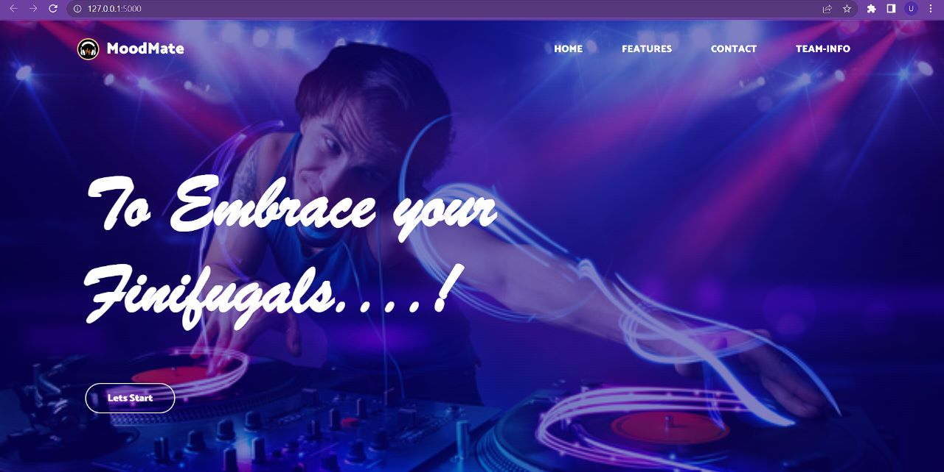
MODELLING

Slide 10
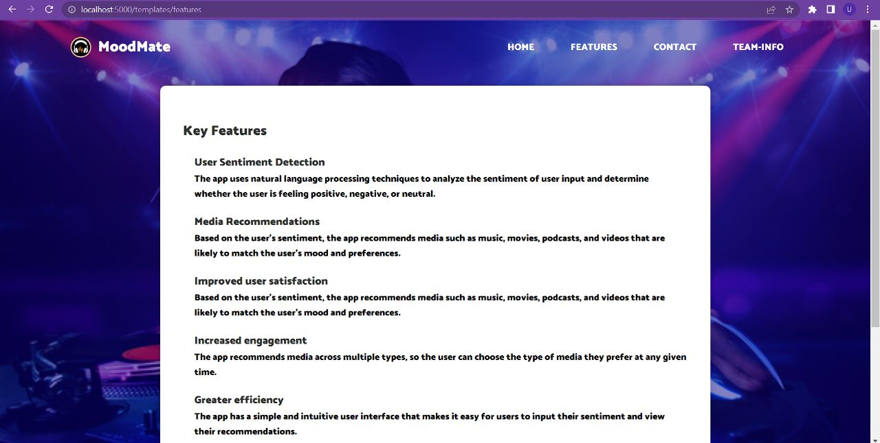
MODELLING

Slide 11
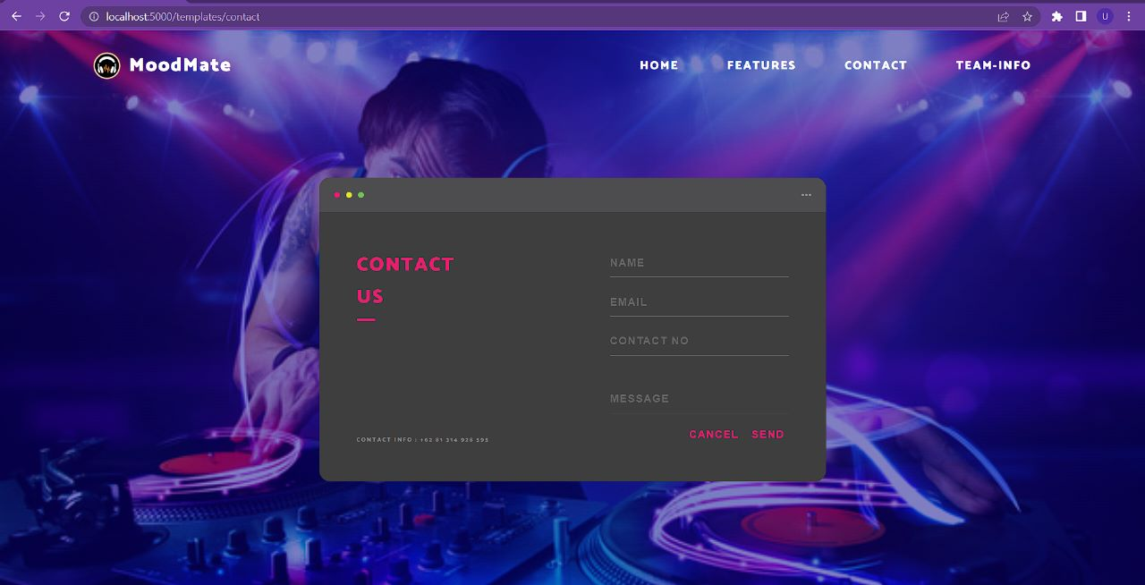
MODELLING

Slide 12
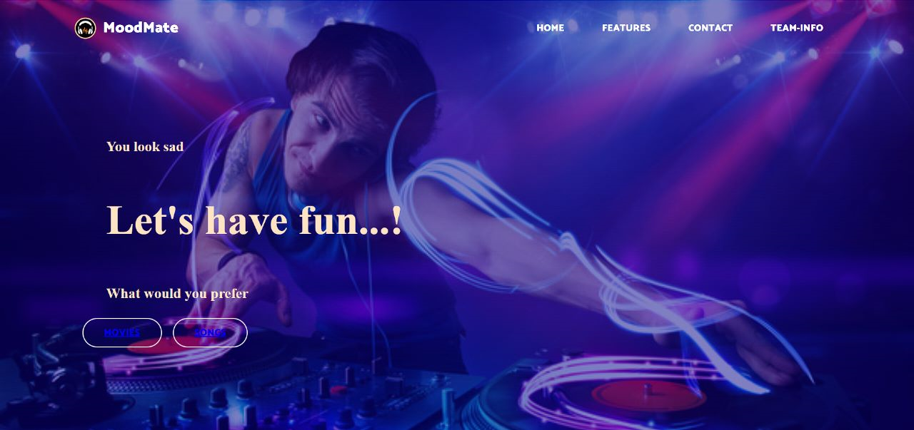
MODELLING

Slide 13
RESULTS
As a result, We learnt about the transfer learning approach for the model, which assisted us in face identification, as well as how to develop basic web pages using HTML, CSS and how to deploy the model on the web using flask.
Demo/Github Link : https://github.com/AutumLeaf/MoodMate.git

Slide 14
CONCLUSION
Creating a project that is effective for the modern generation. Working in unison despite being far away from each other. Creating this awesome project in such a small span of time! Learnt a great deal about Python and different frameworks such as flask and its integration, many new libraries in Python. We thought and build the entire solution in such a small amount of time, overcame all the challenges and find a hack to each problem.

Slide 15
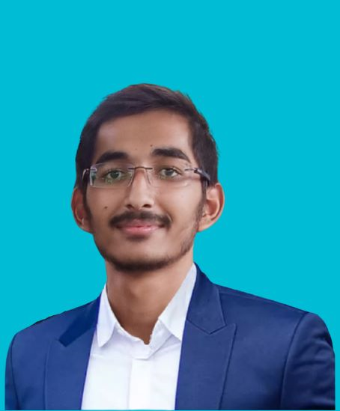
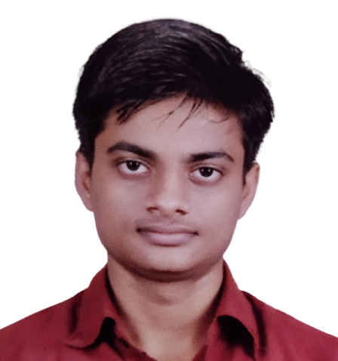
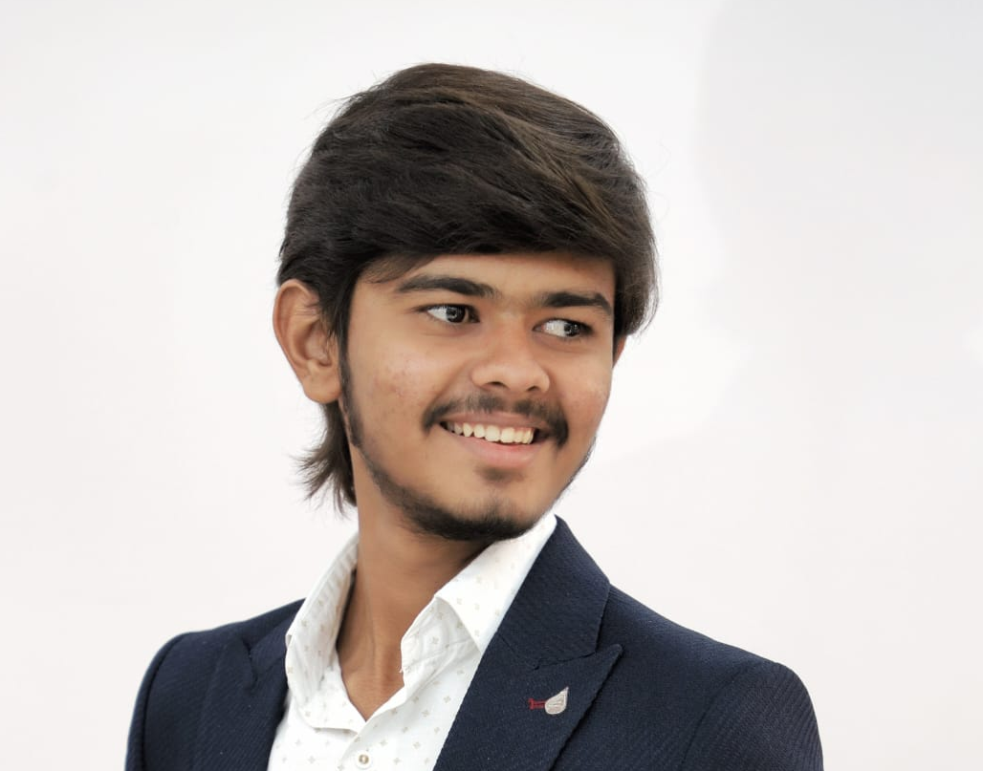

MEET OUR TEAM
Kapadiya Nirav Kumar
Akbari Naimish
Vaghani Taxil
Kachhadiya Kishan

